Slide 1

Business Partner of Artificial Intelligence
SURROMIND ROBOTICS

Slide 2











Business Partner of Artificial Intelligence
1
AI company that pioneer the future with accumulated technology of Seoul National University
AI PLATFORM
SURROMIND
2015. 7. Founded (Founder and CEO: Prof. B.-T. Zhang)
Deep Learning Research Center
Key AI Technologies in “Multimodal Perception-Learning-Action”
Integration of visual, linguistic intelligence and sensory information
2
AI-centric projects and experience
Human-care robot for senior citizens (MSIT, ‘17.4~’21.12)
Sleep-care service (Coway, ’17.4~’19.3)
Smart dialog platform (LGU+, ‘17.5~’18.11)
Mobile service robot (E-Mart, ’18.6~’18.8)
AI SOLUTION
SURROVISION
3
Provider of AI solutions with unique AI platform
Vision-centric solution for natural interaction with users
Including essential microservices to convert visual information into linguistic information
AI PLATFORM SURROMIND
AI SOLUTION SURROVISION
4
Partners and customers
2

Slide 3
SURROVISIONTM
Vision-centric solution
including essential microservice
to convert visual information
into linguistic information
3

Slide 4
SURROVISION
SURROVISION makes your business more effective with analytics of image big data
Especially, it extracts linguistic information from images and helps to interact with users
SURROVISION Microservices
SURROVISION Applications
Image Detection & Classification
Detecting objects and classifying images
Automatic Car Damage Estimation
Identifying the damaged parts and estimating the damage level from car images
Image Labeling & Description
Extracting keywords and phrases that express the content of the image
Visual 20 Questions
AI game that can play 20 questions with users to find objects in the image
Visual Question Answering
Answering short-answer questions about the contents of the picture
Album Storyteller
Adding stories to albums created in cloud photo services
Visual Storytelling
Writing a story for a series of images
4

Slide 5
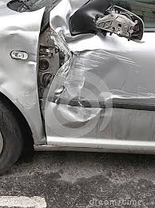
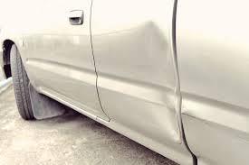
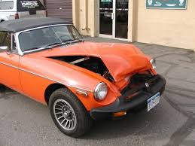
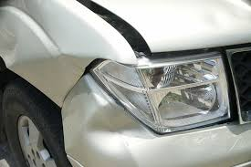
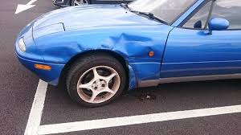
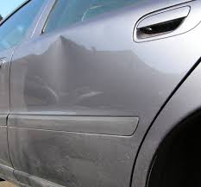
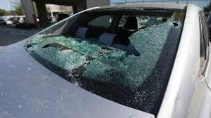
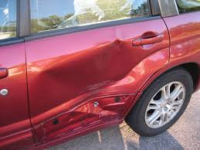
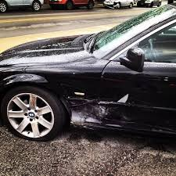
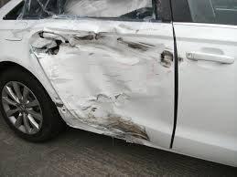
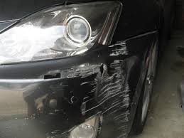
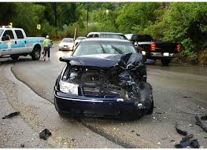
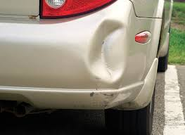
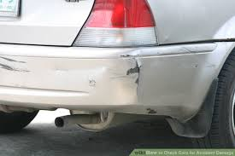
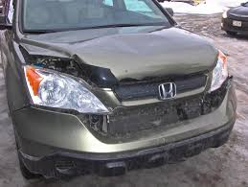
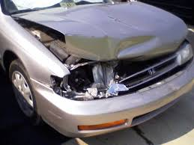
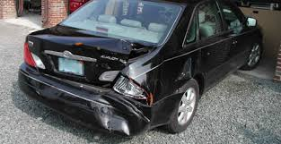
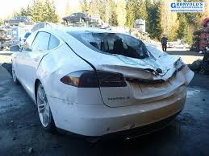
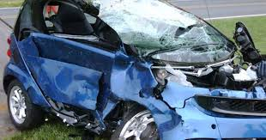
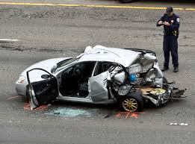
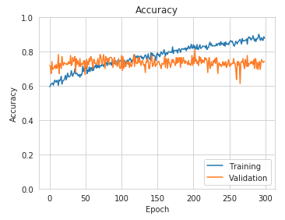
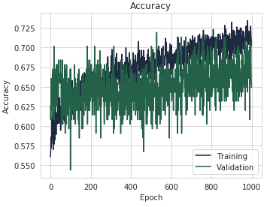
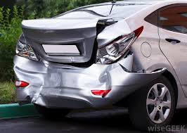
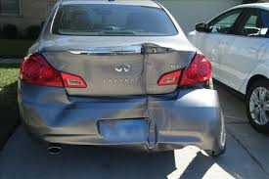
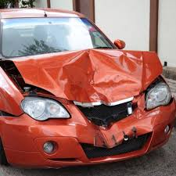
Image Detection & Classification
Powerful classification solutions for objects, scenes, and events
Customization services for your specific classification problems
Damaged Parts (Side/Front/Rear)
Damage Level (Minor/Moderate/Severe)
Accuracy 81 %
Accuracy 72 %
Car Insurance
Car Seller/Reseller
Alarm Events
Machine Vision Apps
Smart Display Apps
5
Notes:
자동차 이용 고객의 출입 정보 분석을 통한 마케팅 강화

Slide 6
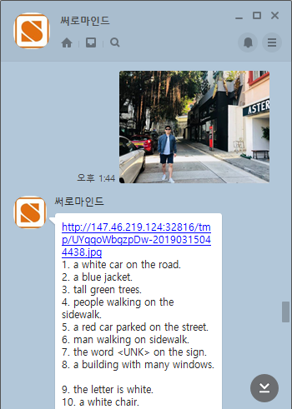
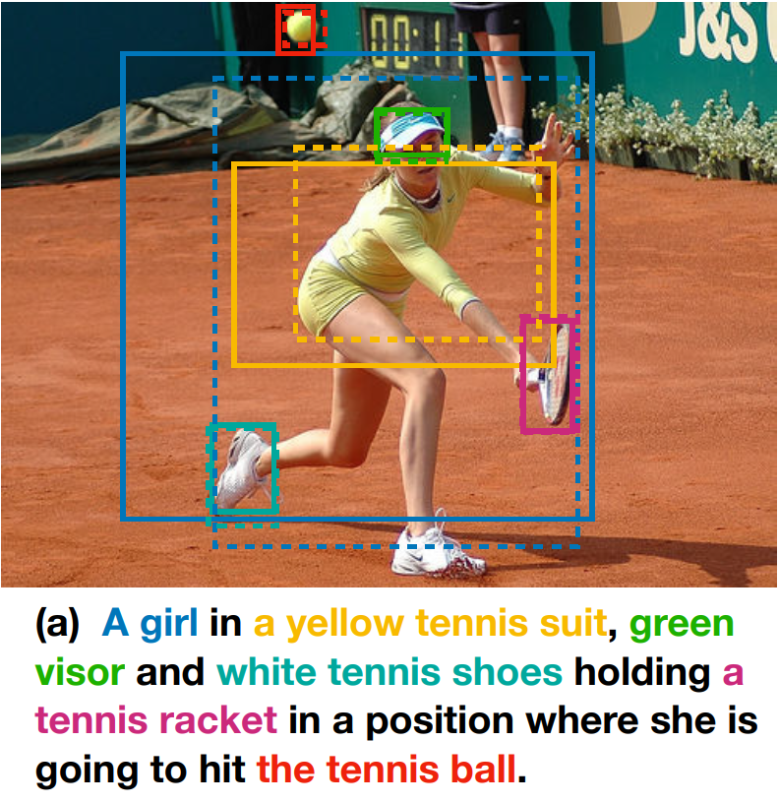
Image Labeling & Description
Extraction and description of linguistic information from image data
Matching image parts with texts
(Presented at NIPS 2018 Conference)
Descriptive texts from an image
(Demo on the Kakao Plus Friend)
Language Education
Tagging for SNS posts
Image Search
CCTV Image Analysis
Smart Display Apps
6
Notes:
상: 실제 구현 사례
중(오렌지 바): 제공할 수 있는 장점
하: 활용 가능성

Slide 7
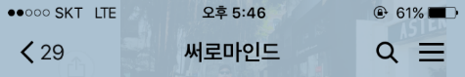
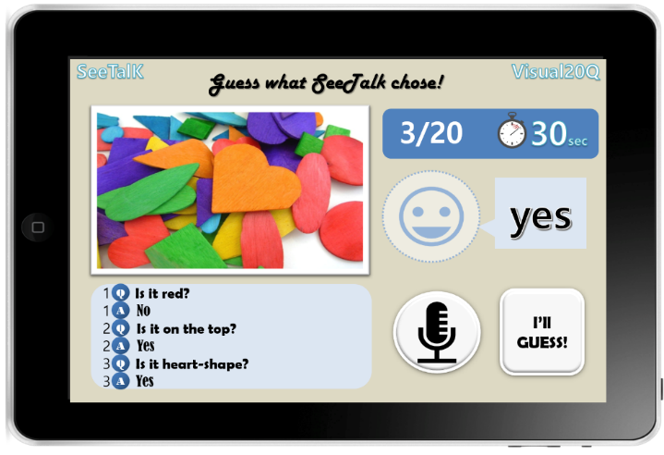
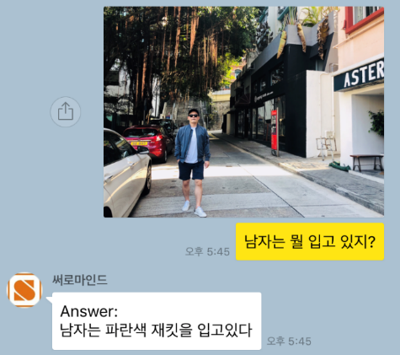
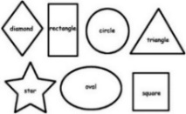

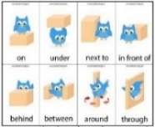
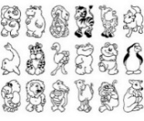
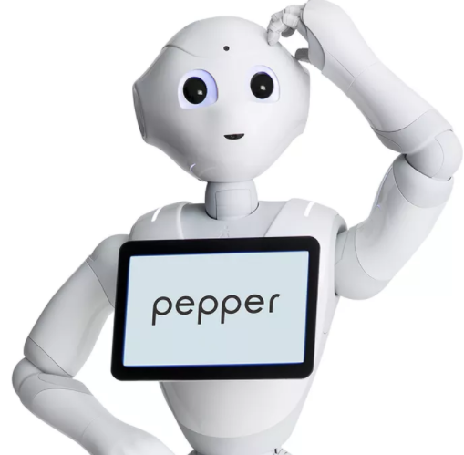
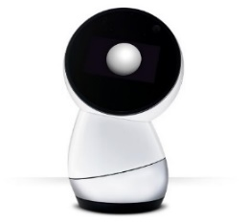
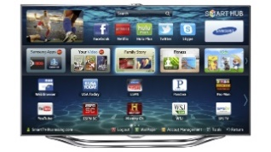
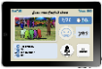
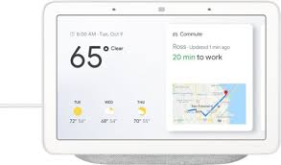
Visual Question Answering
Answering short-answer questions about the contents of the picture
Multiple Q&A’s Example
(20 Questions game on an image)
(http://bit.ly/visual20qna)
What is the man wearing?
Single Q&A Example
(Demo on the Kakao Plus Friend)
The man is wearing a blue jacket.
Maximize usage effect by linking with various smart devices suitable for education target
Apps educate children on visual concepts such as color, shape, and location.
7
Notes:
상: 실제 구현 사례
중(오렌지 바): 제공할 수 있는 장점
하: 활용 가능성

Slide 8
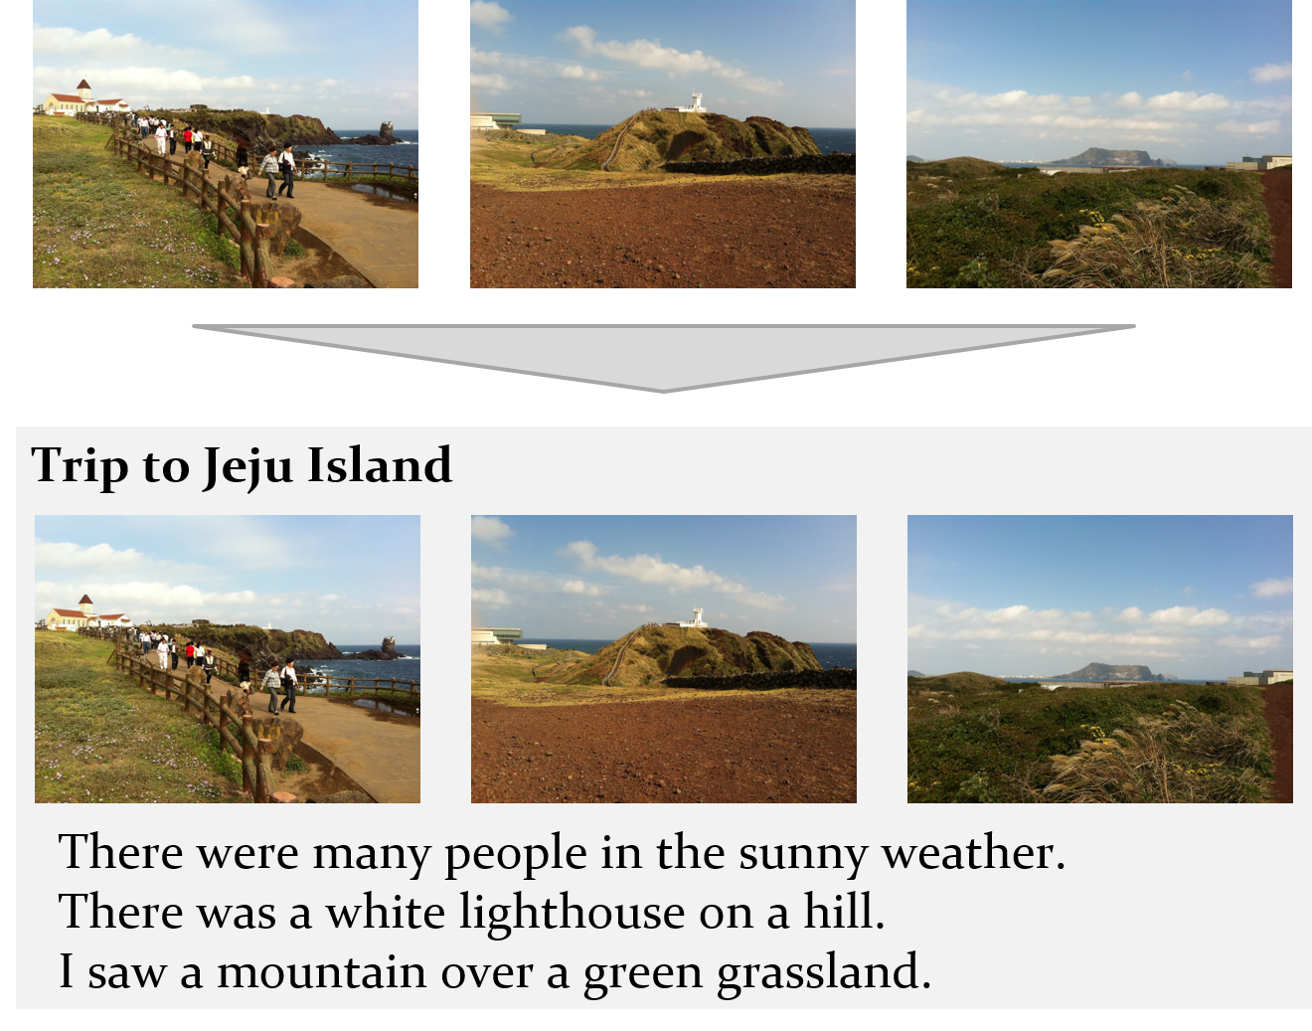
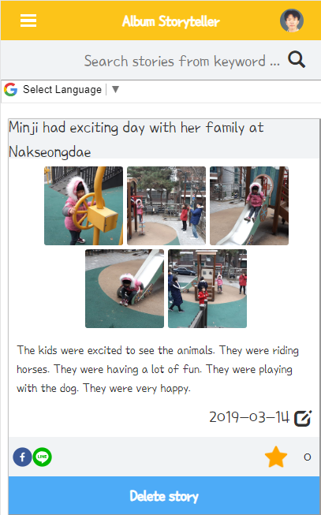
Visual Storytelling
Writing a story for a series of images
Identifying and expressing story elements such as characters, subjects, and events in images
Supporting tool for digital storytelling with images
Album Storyteller
(http://bit.ly/albumstoryteller)
8
Notes:
Authoring Aids: Automatically generate text content associated with photos, or suggest candidate content elements. News articles, blog posts, parenting diary
Creative Aids: These are aids that suggest various phrases linked to pictures. Advertising copywriter, film / game production, YouTube creators
Smart Assistant: Supports automation of photo-based content tasks. Community chatbot, language education, …

Slide 9

Prepare Successful AI Business
with Surromind Robotics
EXPERIENCE IN VARIOUS AI PROJECTS
AI TECHNOLOGY EXPERTS
PREPARED BUSINESS PARTNER
OF ARTIFICIAL INTELLIGENCE
AI SOLUTION FOR IMAGE BIG DATA
Notes:
(좌) AI 비즈니스를 잘 아는 전문가, 고객을 도와줄 수 있다
(우) Exierience, AI solution

Slide 10
Contact
+82 2 872-5127
contact@surromind.ai
http://surromind.ai
THANK YOU

